Slide 1
Coursera Applied Data Science Capstone

Slide 2
Reducing Injury Collisions in Seattle
Seattle ranks one of the worst cities to drive in
One factor is traffic and accident safety
City Council wants to reduce number of injury collisions that occur within the city to improve this factor
What are the best predictors we can use to predict injury collisions?
Other cities with similar city makeup may find this data interesting to reduce injury collisions for their city

Slide 3
Data Acquisition and Cleaning
Data provided by Coursera for the project
Geographic data taken from https://github.com/seattleio/seattle-boundaries-data to help define boundaries for city
After data cleaning, there were 184,346 samples and 39 features in the data.
Duplicate, highly similar, and unique identifiers were dropped as they were not useful for predicting accident severity
Cleaned data contains 13 features

Slide 4
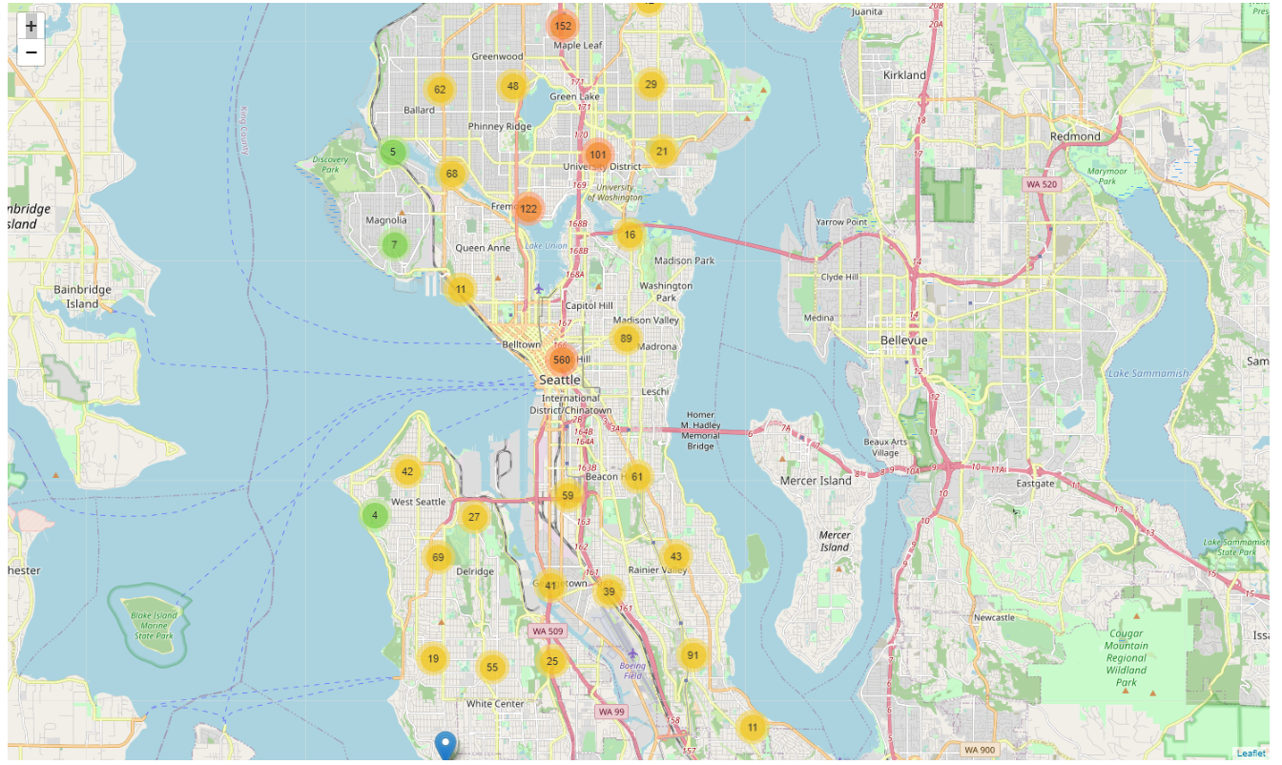
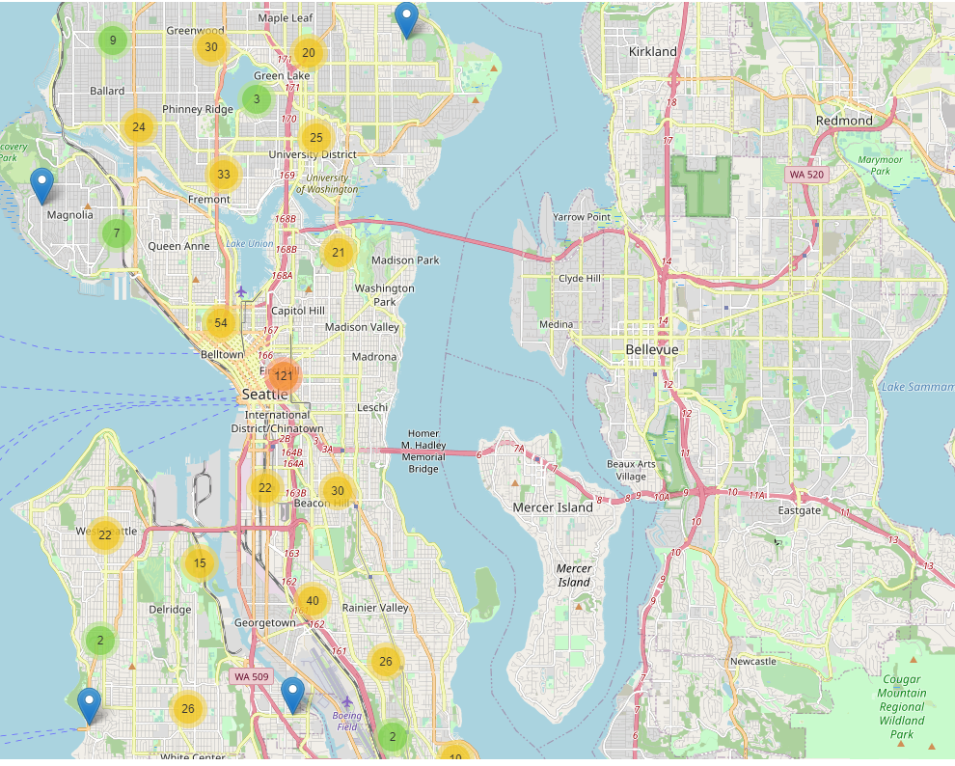
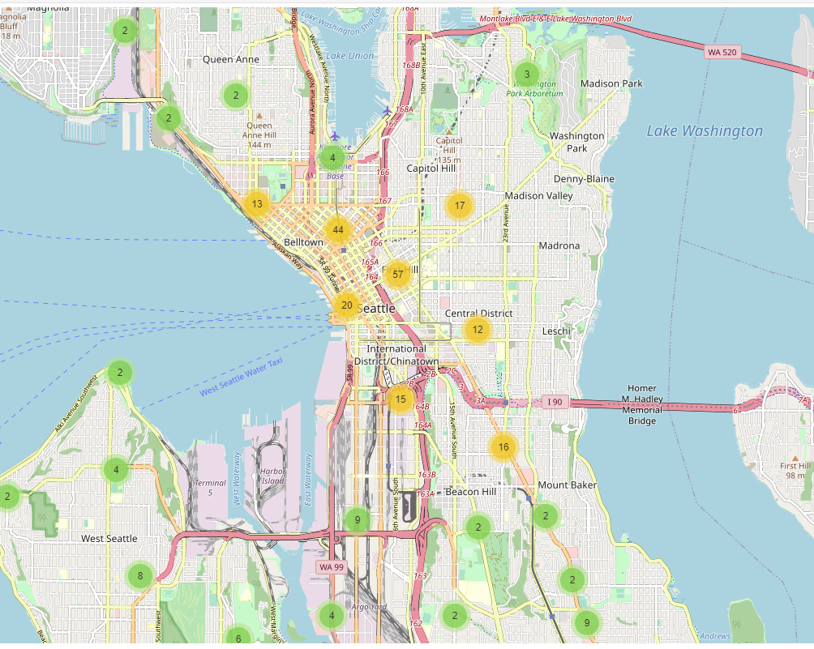
Downtown seattle is ideal starting point for initiatives
Sample of all accidents
Sample of injury collision accidents
Sample of accidents occurring more than once

Slide 5
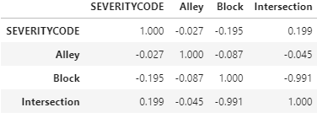
Injury collisions may occur at intersections

Slide 6
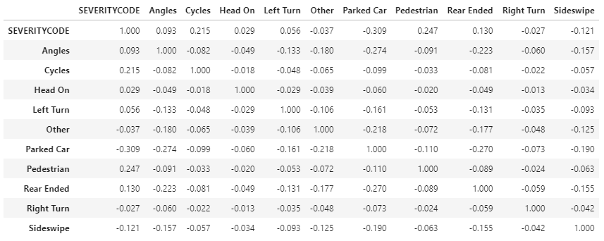
Injury collisions likely involve pedestrians or cyclists

Slide 7
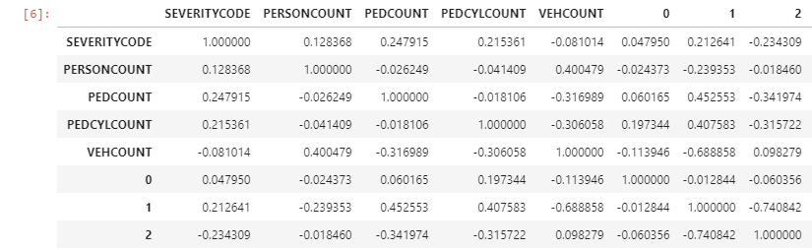
Injury collisions likely occur between 1 vehicle and a pedestrian/cyclist

Slide 8
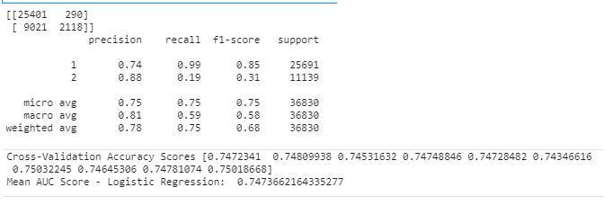
A logistic regression model based on those factors performs with 74% accuracy

Slide 9
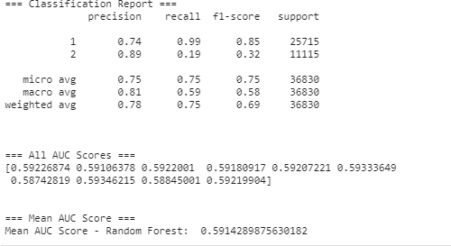
A Random forest predictive model based on those factors performs with 59% accuracy

